Slide 1
Module 3: Optical Communication systems
EXTC – BE – Optical Communication and Networks (ECC801)
Prof. Shyamala Mathi
Assistant Professor
Dept. of Electronics and Telecommunication,
SIES Graduate School of Technology

Slide 2
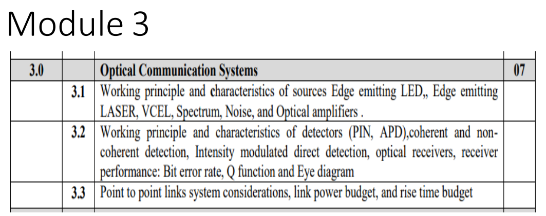

Slide 3
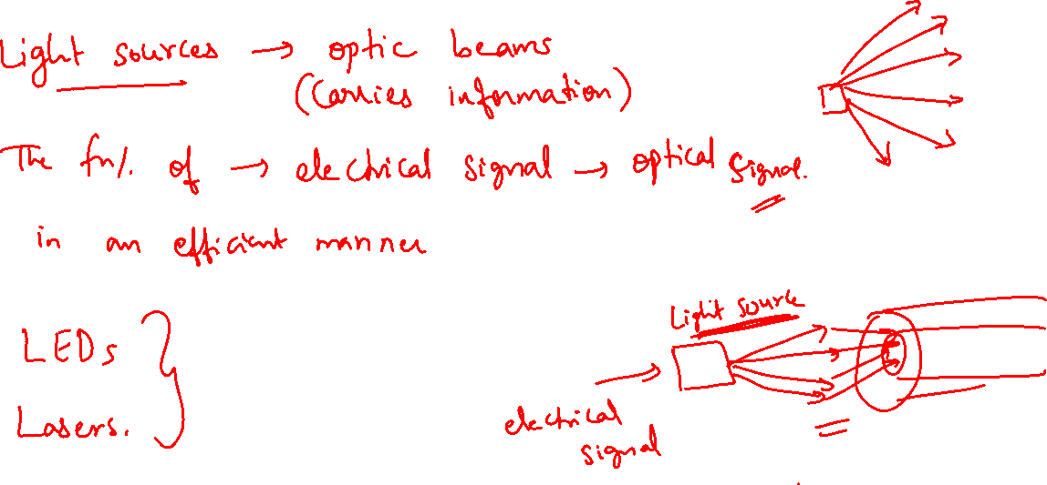
Introduction:

Slide 4
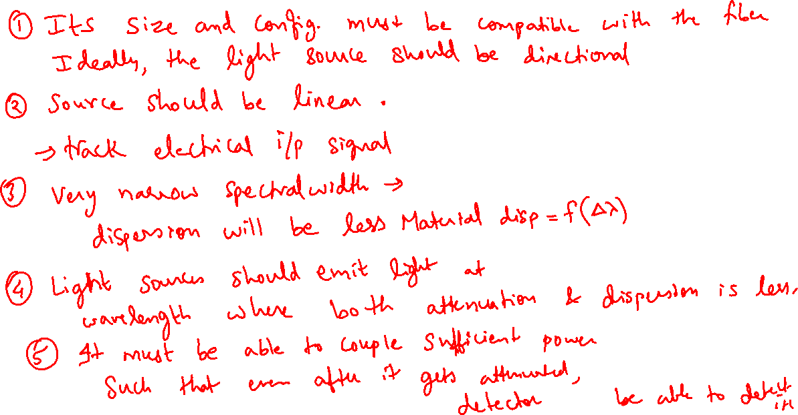
The optical sources must fulfill the following requirements:

Slide 5
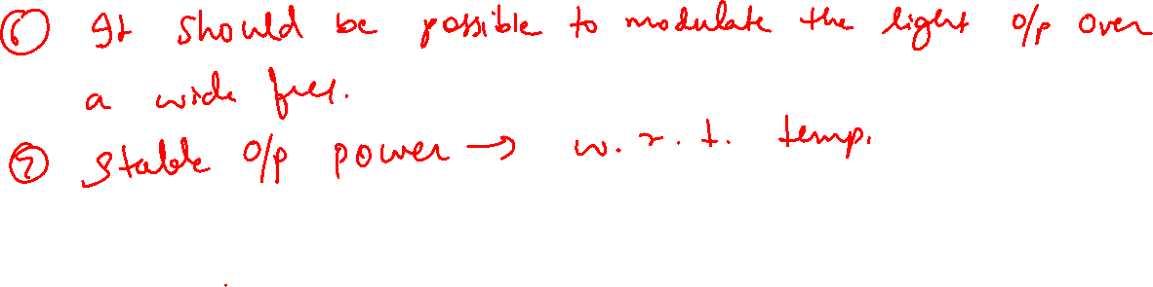

Slide 6
Basic Concepts:
Absorption and emission of radiation
We know from quantum physics that electrons in an atom can occupy only discrete energy levels.
Electrons are found in definite shells having definite energies. These shells are thus known to have discrete energies and are called energy levels. This allows the energy difference between two shells to be fixed i.e. the energy difference is discrete or quantized.

Slide 7
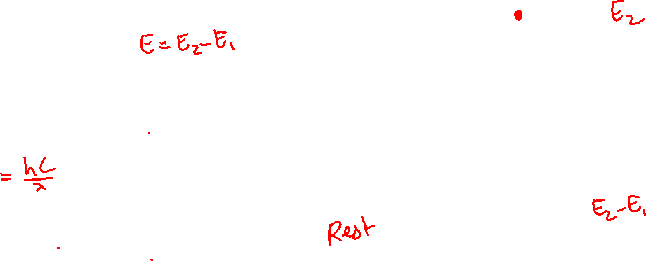
Basic Concepts:
Author - John Senior
Absorption and emission of radiation

Slide 8
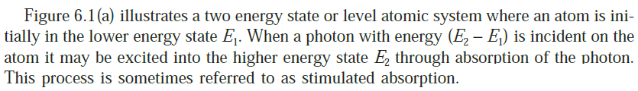
Absorption:
Emission Process:

Slide 9
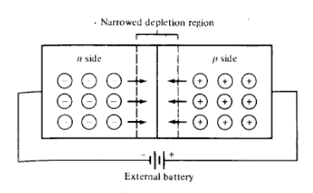


Slide 10
pn Junction Diode:

Slide 14
Electroluminescence: LEDs create light by electroluminescence in a semiconductor material. Electroluminescence is the phenomenon of a material emitting light when electric current or an electric field is passed through it - this happens when electrons are sent through the material and fill electron holes.

Slide 15
The radiative minority carrier lifetime is defined as the average time a minority carrier exist in a free state before radiative recombination takes place.
Where Br = recombination coefficient
N = majority carriers in n-region
P = majority carriers in p-region

Slide 17
LED power and efficiency

Slide 22

Internal Quantum efficiency: It is defined as the ratio of radiative recombination rate to the total recombination rate.
(or)
It is also defined as the ratio of no. of photons generated per second to the no. of carriers injected across the junction per second.

Slide 23
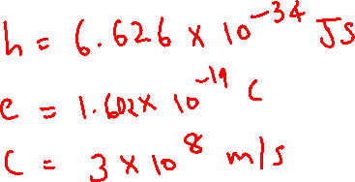
Optical power internally generated: It is defined the product of no. of photons generated per second and the energy of photon.

Slide 24
Since not all the photons generated will exit the device. Therefore to find emitted power, one needs to consider the external quantum efficiency.
External Quantum efficiency: It is defined as the ratio of power emitted to that of Power internally generated.

Slide 25
External power efficiency (ηep): It is defined as the ratio of the optical power emitted externally pe to the electrical power provided to the device P.

Slide 26
Optical power emitted, Pe into a medium of low refractive index n from the face of a planar LED fabricated from a material of refractive index nx is given approximately by

Slide 27
A further loss is encountered when coupling the light output into a fiber.
If it is assumed for step index fibers that all the light incident on the exposed end of the core within the acceptance angle θa is coupled, then for a fiber in air,

Slide 28
Coupling efficiency estimates the percentage of optical power coupled into the step index fiber relative to the amount of optical power emitted from the LED.

Slide 32
1. The power generated internally within a double heterojunction LED is 28.84 mW at a drive current of 60 mA. Determine the peak emission wavelength from the device when the radiative and non radiative recombination lifetimes of the the minority carriers in the active region are equal.

Slide 33
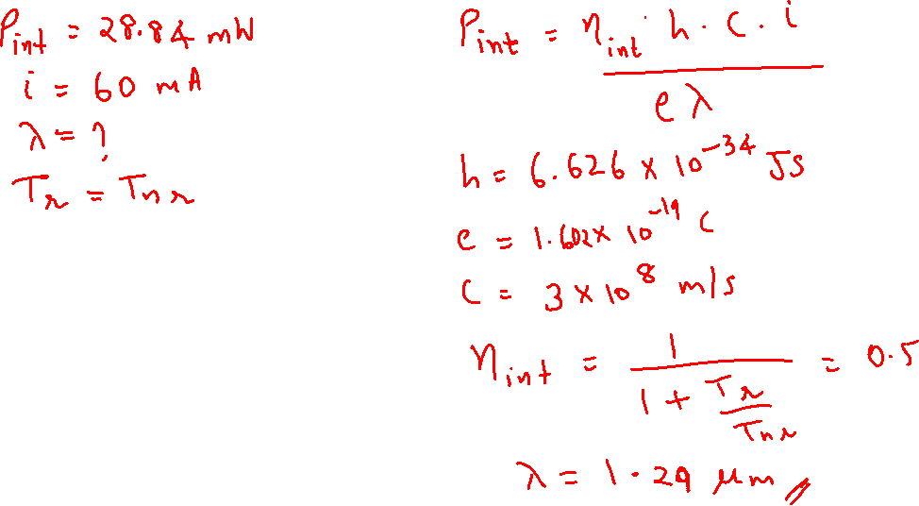

Slide 34
2. Estimate the external powe efficiency of GaAs planar LED when the transmission factor of the GaAs-air interface is 0.68 and the internally generated optic power is 30% of the electric power supplied. The refractive index of GaAs may be taken as 3.6

Slide 35
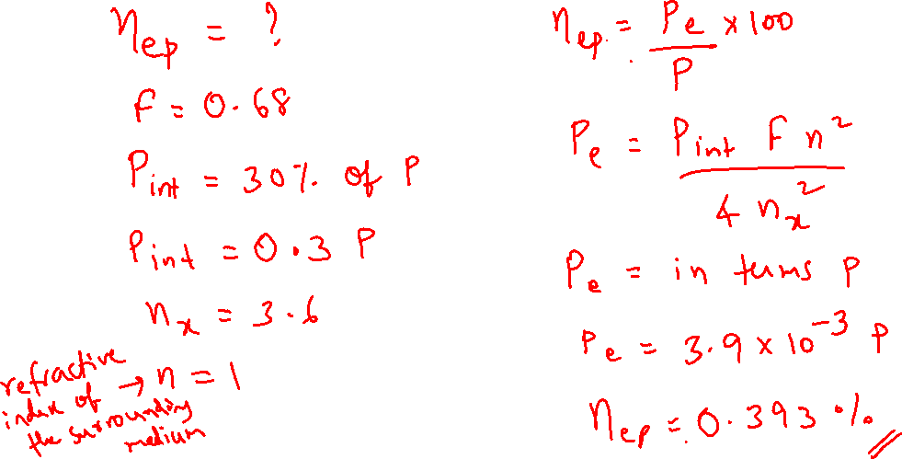

Slide 36
3. The external power efficiency of an InGaAsP/InP planar LED is 0.75% when the internally generated optic power is 30 mW. Determine the transmission factor for the InP-air interface if the drive current is 37 mA and the potential difference across the device is 1.6V. The refractive index of InP may be taken as 3.46.

Slide 37
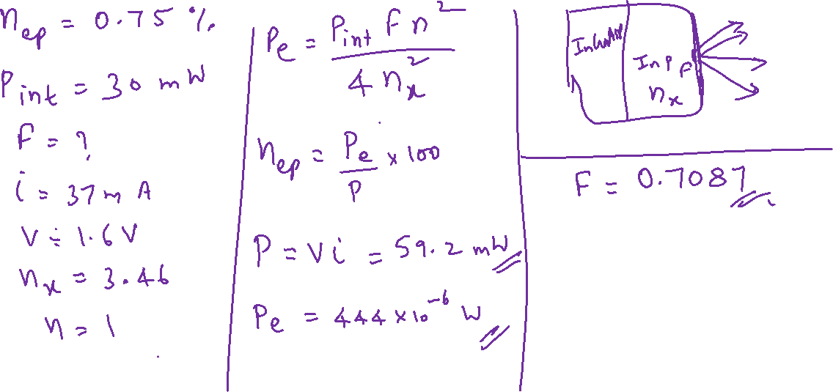

Slide 38
4. The external power efficiency of a planar GaAs LED is 1.5% when the forward current is 50 mA and the potential difference across its terminals is 2V. Estimate the optical power generated within the device if the transmission factor at the coated GaAs-air interface is 0.8. Refractive Index of GaAs is 3.6.

Slide 39
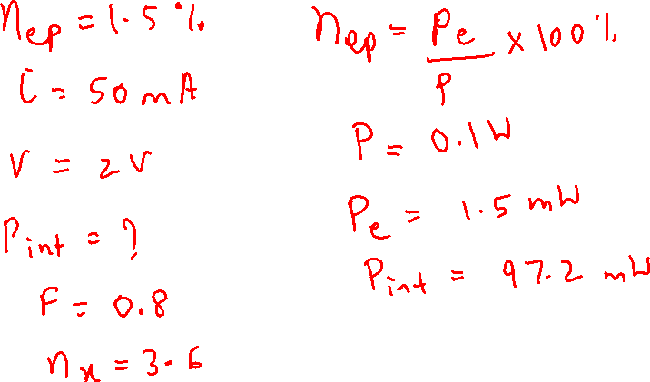

Slide 40
5. When a LED has 2V applied to its terminals, it draws 100 mA and produces 2 mW of optical power. What is the LED’s conversion efficiency from electrical to optical power?

Slide 41
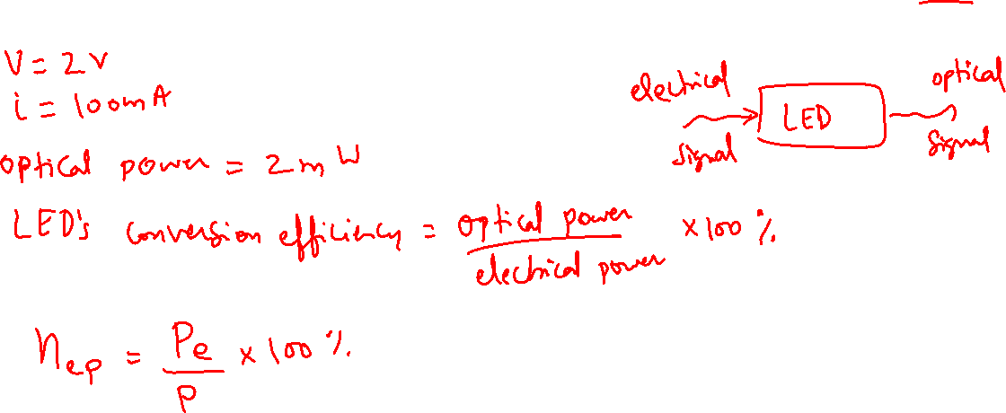

Slide 42
Thank You!
(shyamalae@sies.edu.in)

